Slide 1
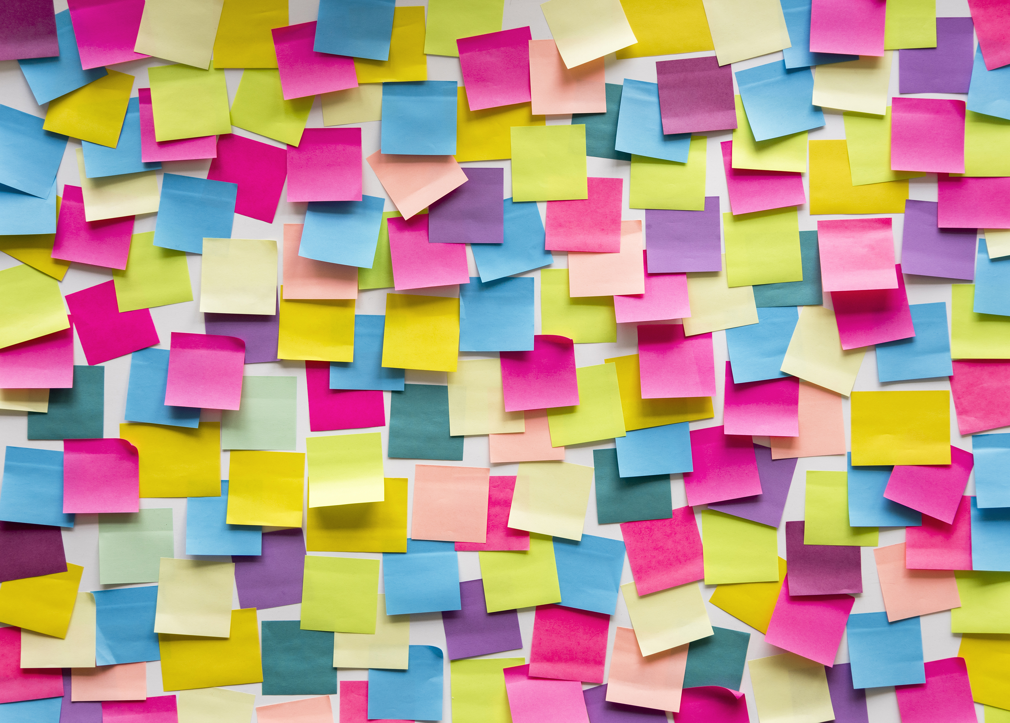








NFTs
And Our Journey To The Creation Of The Cryptobara Collection
A project by: Marcela Castano Rina Weiner Frank Lau Monique Ferguson

Slide 2
Overview
Let’s make an NFT!
Artistic Development
Pinata and IPFS
Smart Contract
Minted Cryptobara Collection & Dapp

Slide 3

Wait, what’s an NFT?
Did you know that NFT was Collins Dictionary Word of the Year 2021?

Slide 4
Importance of NFTs
Look around, from the art world to significant businesses and even high-profile celebrity products, NFT technology is slated to change the nature of digital ownership permanently.
However, behind the hype of owning digital items is a much bigger and more important picture. NFTs are on the verge of totally revolutionizing trade finance and global commerce.
There is the potential to tokenize a wide range of assets and connect the finance world to decentralized finance (DeFi) markets.
Trade finance instruments, such as fixed income products and investment notes, can securely move along the blockchain in a way that brings transparency, promotes seamless settlement, and grows liquidity.
Also, smart contracts eliminate intermediaries, diminish counterparty risk and maintain the integrity of deliverables.

Slide 5
Importance of NFTs
NFTs are more than just pngs and jpegs on a blockchain — they represent digital ownership.
They are constructed upon smart contracts and blockchain technology, the same decentralized networks that command many popular cryptocurrencies.
Blockchain platforms are highly secure and offer entirely verifiable data and an immutable ledger history.
Smart contracts, meanwhile, are self-executing, predetermined transactions that reside on the blockchain and define how the assets on the blockchain work.
NFTs can take any information and give it a form of uniqueness by making it cryptographically unique from any other batch of data.
The data encoded into an NFT cannot be changed, counterfeited, or in any way accessed by anyone not in possession of the pertinent cryptographic keys.

Slide 6
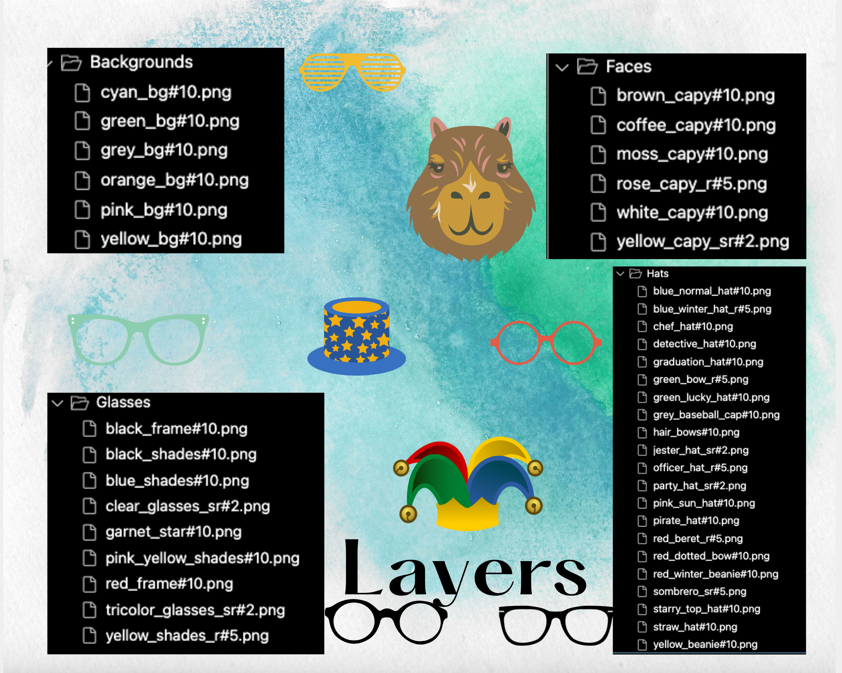
Layers

Slide 7
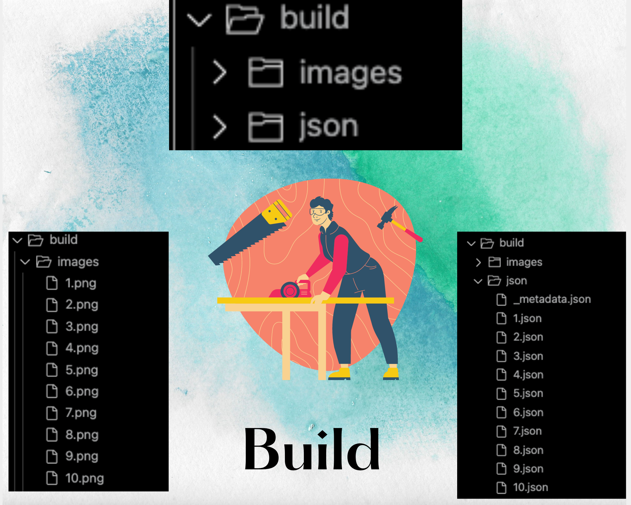
Build

Slide 8
Preview Images

Slide 9
Pixelated Images

Slide 10
Smart Contract

Slide 11
Dapp on Streamlit

Slide 12
Explain how this project relates to fintech

